Slide 1
SPS Secondary Beam Experimental Areas
Access System
7 September 2012

Slide 2
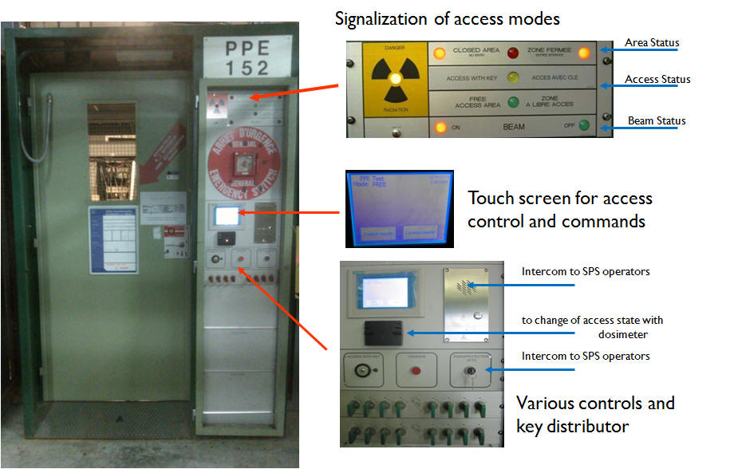
Access Point-Access Modes
FREE : open - anyone can enter
KEY ACCESS : everyone entering needs a key - all keys in place for beam ON
CLOSED : no access is allowed - beam can be switched ON
LOCKED : no access is allowed - beam cannot be switched ON
PATROL : transient mode between FREE to KEY ACCESS during the Search and Secure Procedure
Radioprotection Veto

Slide 3
Free Mode
If more people than keys (during installation or shutdown) → switch the access point to FREE MODE in the panel mode and validate
Important notes:
No key needed for access
To switch back from FREE to KEY ACCESS or CLOSED mode a search and secure procedure (patrol) of the experimental area, to be done by authorized people

Slide 4
Key Access Mode
GET A KEY: Touch Key release on the screen. Take the key indicated by the red LED.
Enter tHE area: Put the key in the lock and open the door.
Important rule: one person one key (more people than keys → FREE MODE)
Important notes:
Do not push the Emergency Passage button above the door handle, except emergency (search procedure, lock to be rearmed → waste of time).
Do not block the door open. If door remains open for long, automatically switches to FREE MODE.

Slide 5
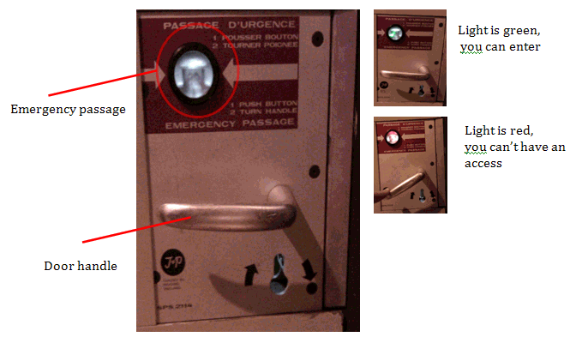
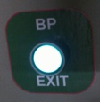
Key Access Mode
Exit tHE area: Press the small green button next to the PPE door or exit from any PPX door and put the key back

Slide 6
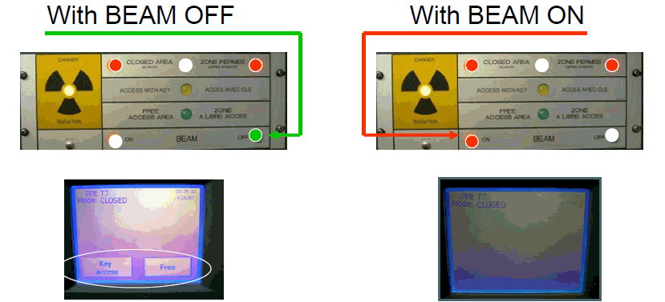
Closed Mode
To switch an access point from CLOSED to KEY ACCESSS mode, the beam must be off
ACCESS : touch the screen to switch to KEY ACCESS or FREE mode and VALIDATE
END OF AN ACCESS: when KEY ACCESS is finished and the last key in place touch End of Access and VALIDATE

Slide 7
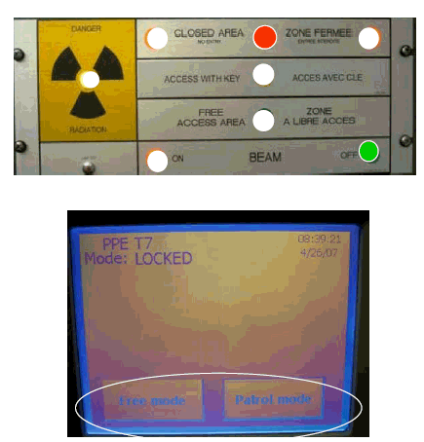
Locked Mode
Locked mode from free access (touch screen) without a patrol.
When locked only FREE MODE and PATROL MODE commands authorized
ASK FOR HELP
In case of problem, contact SPS operators via PPE intercom or phone (77500/70475)

Slide 8
Patrol Mode
Ensure there are no people in the area
All search boxes must be progressively rearmed
Check that anything allowing illegal access to the area are removed
Once the area is patrolled and the door shut, all of the keys must be in place.
More info at EDMS 1138831 and EDMS 1138833

