Slide 1
East Area Secondary Beam Control User Guide
Revised version after LS1
L.Gatignon / EN-MEF
5 January 2015

Slide 2
From where
The East Area secondary beam lines are controlled from the EBCR. This room is located on the first floor, above the T10 control room, downstream of the T11 area.
You can access this room easily from the big gate (Porte 18) on the Bldg 251/252 side.
Many beam elements can
be controlled from the user control rooms.

Slide 3
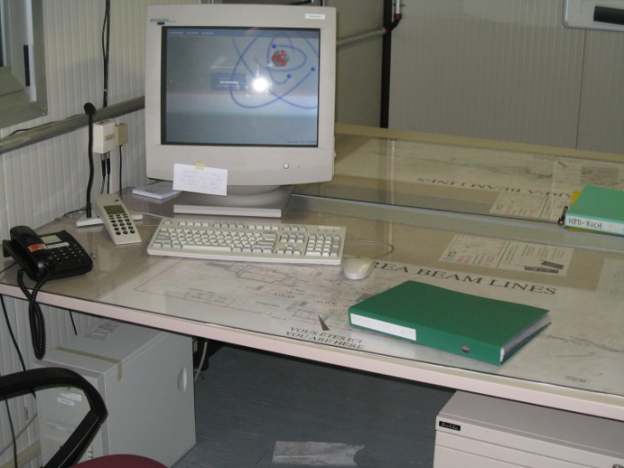
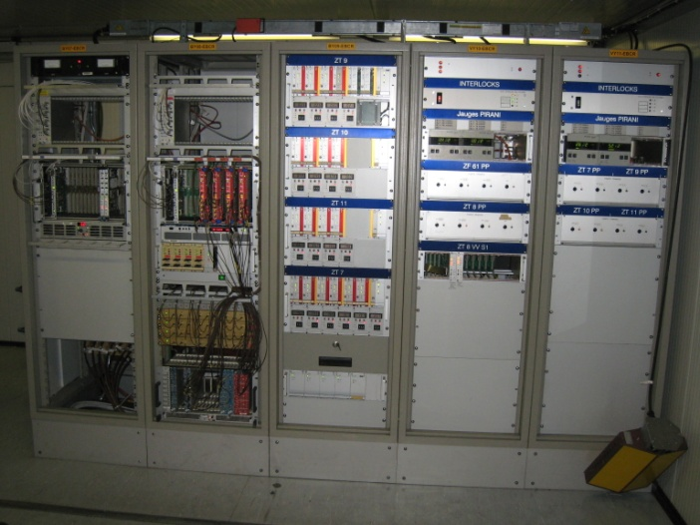
Tools for Beam Control
There is a PC for magnet control (both beam and spectrometer magnets) and detector readout
A series of racks allows to control collimators, vacuum, access signals from the barracks and get timing signals

Slide 4
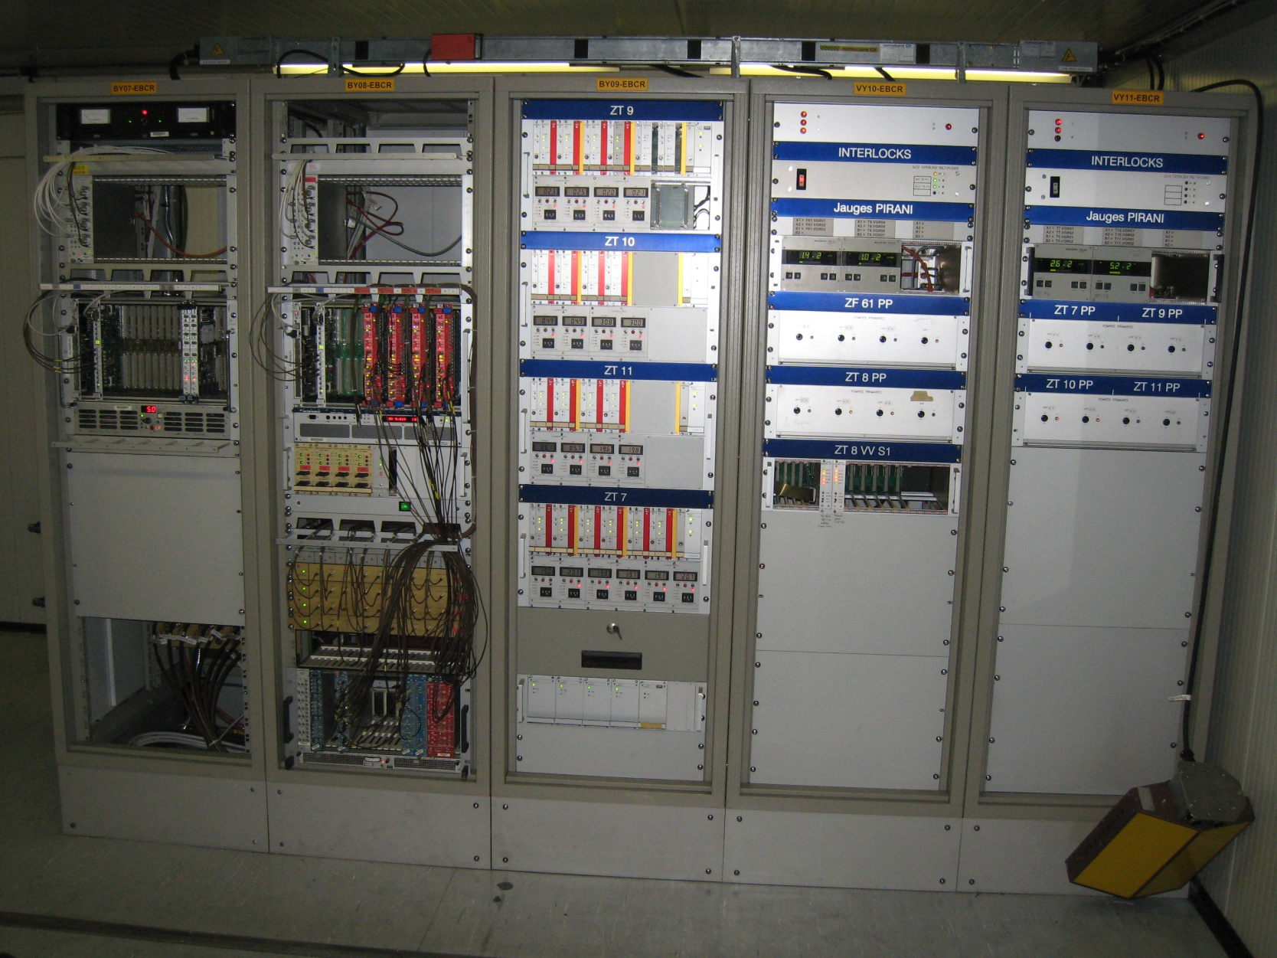
For experts:
DRIFT CHAMBERS
VACUUM CONTROL
For users:
COLLIMATORS

Slide 5
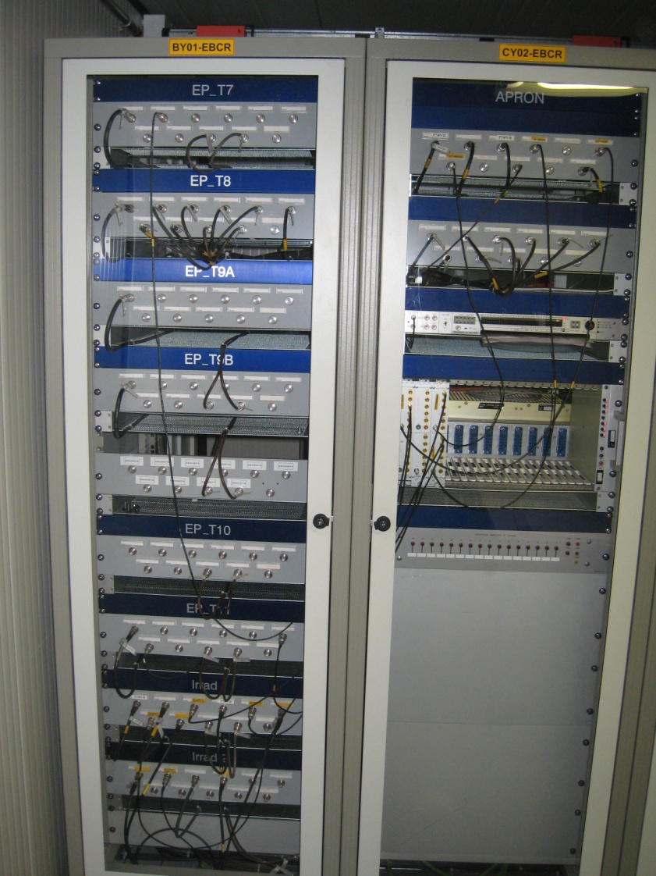
TIMING AND OTHER SIGNALS
Two more racks provide timing signals and connections with the user barracks
Communication
with APRON (primary
beam electronics and
RP barrack)
Communication
with user barracks
Timing distribution

Slide 6

Magnet and detector control
Beam control PC (user: eaop
passwd: . . . . . . . . )
Magnets and detectors are controlled
and read from the Linux PC in the EBCR
or from the beam computers in the
user control rooms
Magnets and detectors are
controlled from the CESAR
beam control program.
The use of Cesar is described in the Control Summary Sheets (quick User Guide:
http://sba.web.cern.ch/sba/Documentations/docs/Controls-Summary-Sheet.pdf
also available as plastified sheets
in the EBCR.
Folder with reference
settings and general info

Slide 7
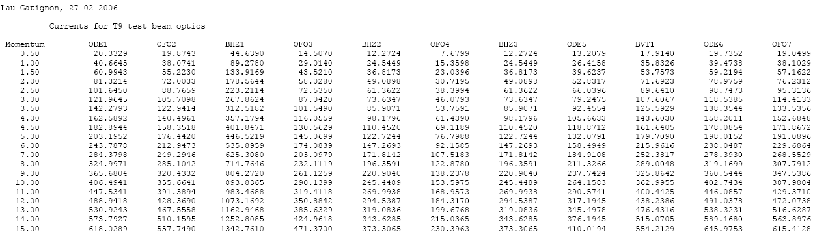
Magnets: Which current?
Lists of currents for each energy are available in the green folder.
Whenever you change energy, all currents must be modified using the knobs.
Normally the sign of the current corresponds to the sign of the beam particles
(except possibly for ZT9.QFO03 – ask your liaison physicist)
Please check carefully that you are changing the right rectifier in the right beam!
(In each knob the name of the magnet contains the name of its beam line, e.g. ZT9.BHZ1)
Do not use the currents in the old printed User manuals. They are obsolete.
Please consult the liaison physicist if you have special beam requirements,
e.g. different focusing of the beam.

Slide 8
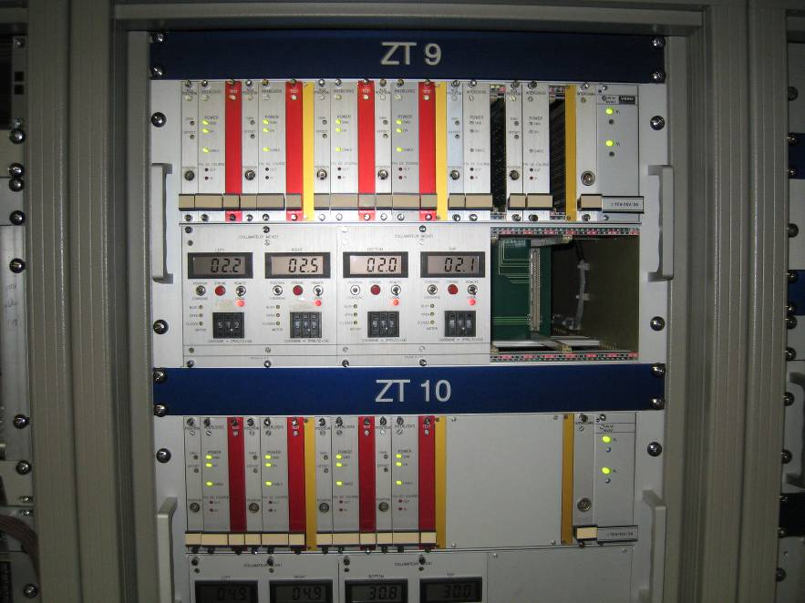
Collimator control
Find the crate controlling the collimators in your beam line
If you want to open to (-x, +y) mm, dial 50+x/2 and 50+y/2 with the thumbwheels
Push on the red STROBE buttons
The final position in mm is shown on the LCD screens. Push STROBE again if the setting reached is not precise enough.
The horizontal collimators usually define Δp/p with typically Δp/p=±1% for ±5 mm gap (see User manual).
The vertical collimators control the angular acceptance and hence the beam flux and the divergence at your detector. Check in the green folder
LCD screens
Thumbwheels
x
y

Slide 9
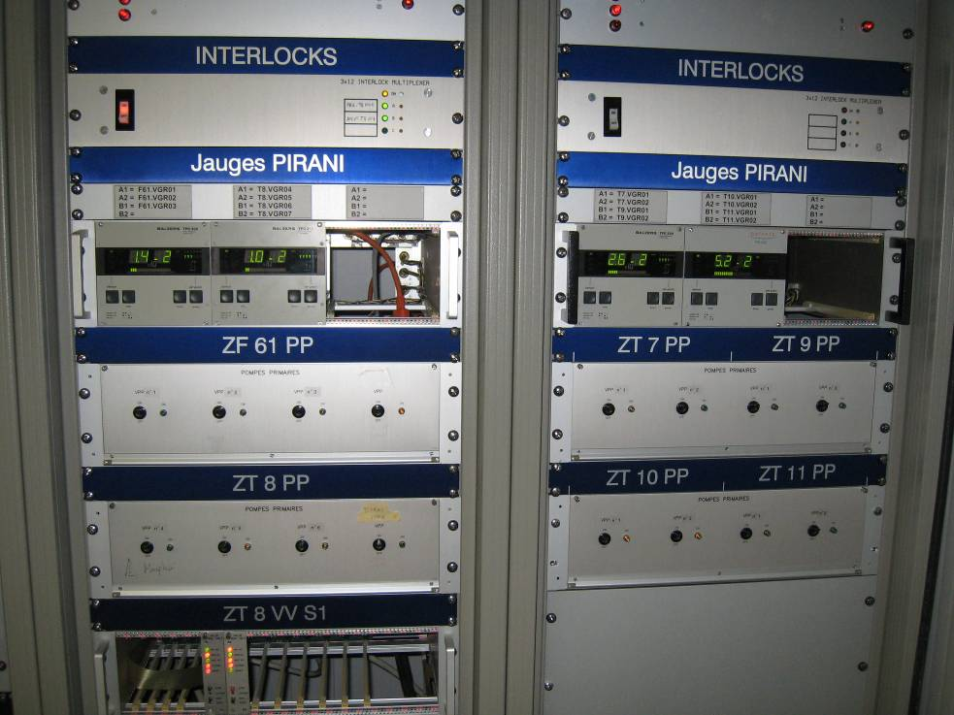
Vacuum control
The vacuum control is regularly checked by experts from the AT/VAC group.
However, the user can check the vacuum in his beam line in case of problems.
Typical values are in the few 10⁻² mbar ballpark

Slide 10
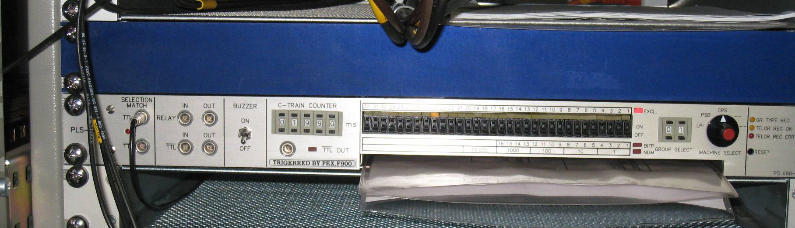
TIMING SIGNALS
Pulse at start of
extraction (→ delay)
Delay (in msec) from
start of PS cycle
Select the wanted cycles
Signal during full PS
cycles selected
Paper documentation
The detailed documentation is available in the paper document inside the module
The North branch (T9, T10, T11) uses EASTA cycles, the T7 line and IRRAD the EASTC cycles. DIRAC uses EASTB.

Slide 11
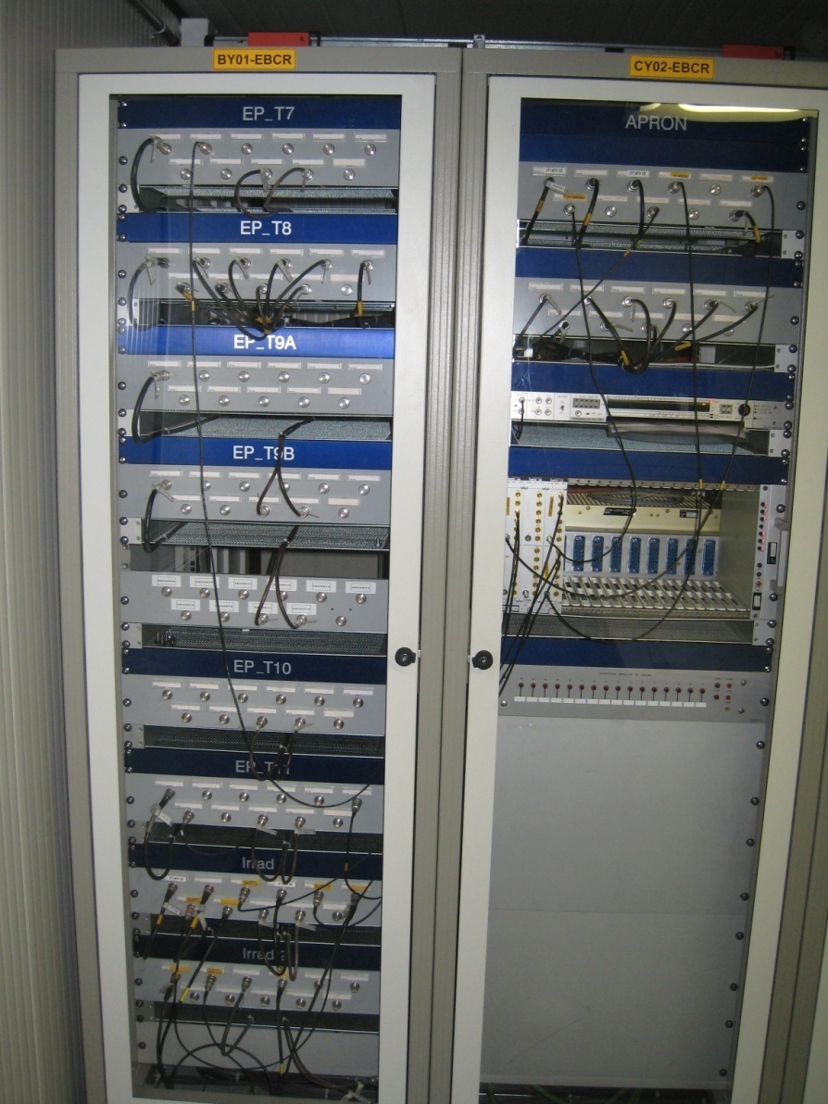
Communication with barracks
There are several cable connections between the user barracks and the EBCR. The name of the barrack is written on the blue panels above each patch panel.
Please check the labels for the correspondence between the barrack and EBCR connectors

Slide 12
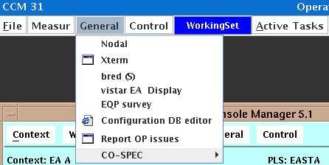
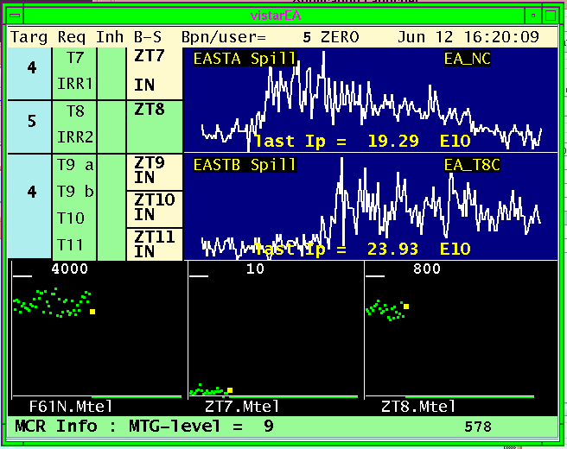
Information from the PS machine
Activate EA Vistar from the
General menu in the
Java Console Manager:
The white curve shows
The shape of the spill over
Its 400 msec length
The green dots indicate the
Intensity per spill for the different
Target telescopes

Slide 13
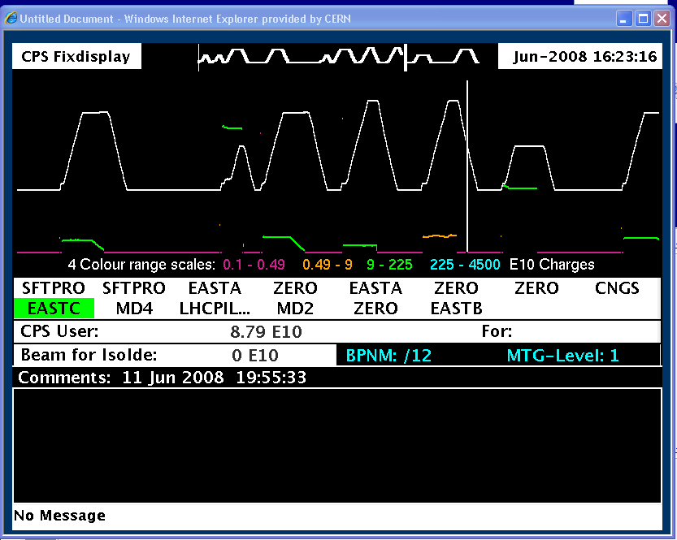
The Vistar on the TV screen shows the overall state of the PS (+ cycles):
Magnet current
Inst. Intensity
Active cycle
Cycle intensity
Comments from
the operators

Slide 14
Further Information
There is a web page:
http://cern.ch/gatignon/EastArea
The access system operation is described in http://cern.ch/gatignon/EastArea/Access.html
Call the CCC (76677) for operational problems
(24 hrs/day, 7 days/week)
Call your liaison physicist (L.Gatignon, 163554) for other questions and requests (during working hours)

